Slide 1
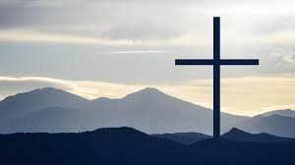
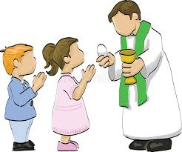
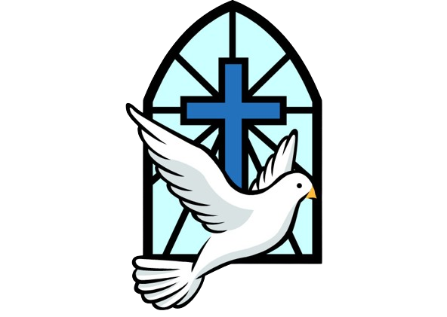
Key Content (New Learning)
know why people show commitment in different ways. |  | know how different practices enable Christians to show their commitment to God and understand that some of these will be more significant to some Christians than others. | know why I think some ways of showing commitment to God would be better than others for Christians.
Unit Overview |  |  |  | Key Vocabulary
Lesson 1 Lesson 2 Lesson 3 Lesson 4 Lesson 5 Lesson 6 End Point | To understand what committed views are. To know how Christians show their commitment to god. To understand what showing commitment looks like. To know what Holy Communion and confirmation is. To know what denomination and rites of passage are. To understand how people show commitment in different ways. To write a poem |  |  | Communion: – the sharing or exchanging of intimate thoughts and feelings, especially on a mental or spiritual level. Confirmation: – A ceremony which sees a young person making a commitment to lead a Christian life. Denomination: – A group within a religion. Rites of passage: – a ceremony or ritual that marks an important transition in an individual's life Commandments: – laws spoken by God to Moses on Mount Sinai
RE Knowledge Organiser
Term 6 – Christianity

