Slide 1
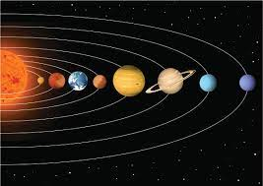
Key Content
Understand adjectival agreement to describe the Solar System in French |  | Know to add an ‘e’ to make the adjective agree with feminine nouns | If the adjective ends in ‘eux’, remove the ‘x’ and add ‘se’. | Know how to ask and answer key questions in French
Unit Overview |  |  |  | Key Vocabulary
Lesson 1 Lesson 2 Lesson 3 Lesson 4 Lesson 5 End point | To know the 10 key elements of the solar system in French To begin to learn adjectives to describe the solar system To use conjunctions to expand descriptive sentences To learn questions in French to ask an astronaut Prepare a presentation as if you were an astronaut going on a mission End of unit assessments- speaking, listening, reading, and writing |  |  | Le Soleil - the sun Mercure - Mercury Vénus - Venus La Terre - the Earth La Lune - the Moon Mars - Mars Jupiter - Jupiter Saturne - Saturn Uranus - Uranus Neptune - Neptune
French
Unit 4- les planetes

