Slide 1
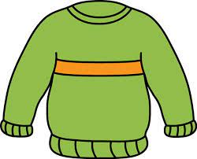
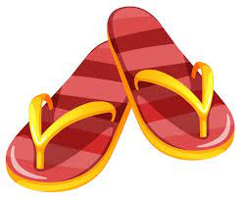
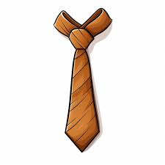
Key Content (New Learning)
Recognise and recall from memory 21 items of clothing |  | Explore the regular ‘er’ whole verb present tense conjugation of the verb PORTER to describe what you and possibly somebody else is wearing | use the possessive adjective ‘my’ in French and describe clothes in terms of colour
Unit Overview |  |  |  | Key Vocabulary
Lesson 1 Lesson 2 Lesson 3 Lesson 4 Lesson 5 End Point | Learn the 10 nouns for items of clothing in French Learn 11 more nouns for items of clothing in French Know how to use ‘je porte’ to say I wear To describe items of clothing by colour and learning how to say ‘my’ in French. Describe what I am packing in my suitcase for a holiday. End of unit assessment |  |  | Un maillot de bain- a swimsuit Un manteau- a coat Des sandales - sandals Un pull- a jumper Un tee shirt- t shirt Un chemisier- a short sleeved shirt Un short- shorts Un pantalon- trousers Une echarpe- a scarf Une robe- a dress Une casquette- a hat Une chemise- a shirt Une cravate- a tie Une veste- a jacket Une jupe- a skirt Des gants– gloves Des chaussures- shoes Des chaussettes- socks Des collants- tights Des bottes-boots Des lunettes- sunglasses
French Knowledge Organiser
Term 3 – Clothes

