Slide 1
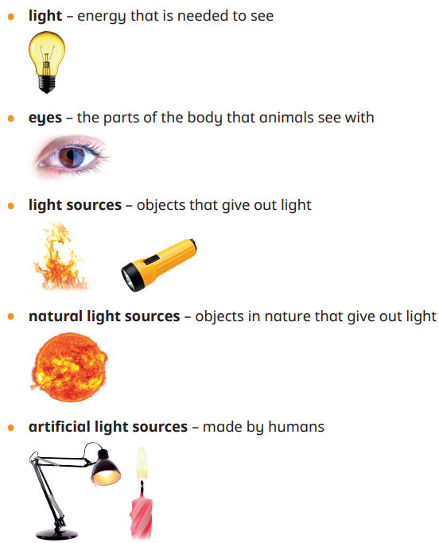
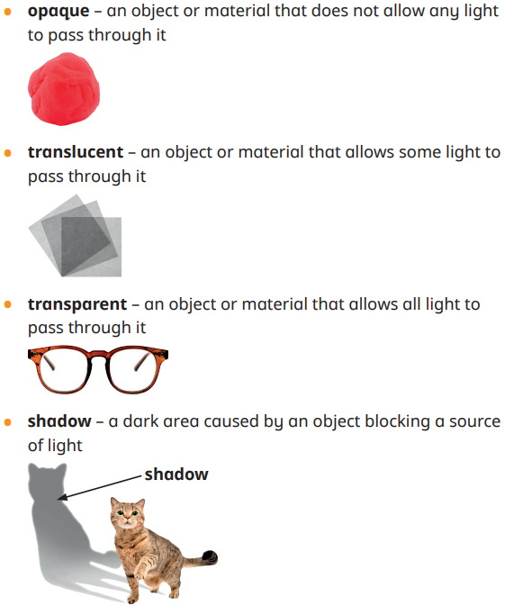
Key Content (New Learning)
Explain that they need light in order to see things and that dark is the absence of light. |  | Explain how light is reflected from surfaces. |  | Explain how and why patterns and sizes of shadows change.
Unit Overview |  |  |  | Key Vocabulary
Lesson 1 Lesson 2 Lesson 3 Lesson 4 Lesson 5 Lesson 6 End Point | To explore light sources and the sun To explain how we see. To investigate shadows To investigate shadows To investigate opaque, transparent and translucent To recap our learning End of Unit Assessment
Term 6 Science Unit Overview
Light
Explain that shadows are formed when the light from a light source is blocked by a solid object.

