Slide 1
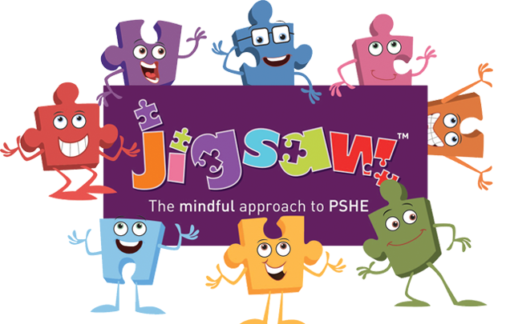
Key Content (New Learning)
understand that cultural differences sometimes cause conflict understand what racism is |  | respect my own and other people’s cultures | compare my life with people in the developing world | understand that rumour spreading and name calling can be bullying behaviour
Unit Overview |  |  |  | Key Vocabulary
Lesson 1 Lesson 2 Lesson 3 Lesson 4 Lesson 5 End Point | To accept that everyone is different. To understand what racism is. To know how to help if someone is being bullied. To understand the impact of money. To understand different cultures To present information about different cultures, including information that compares lives. |  |  | Culture- the language, customs, ideas, and art of a particular group of people. Racism- the opinion or belief that a particular race of people is better than another race or races. Difference- being different Bullying- to frighten or hurt. Continuous repetition of behaviours that negatively impact another intentionally. Discrimination- the act of treating some people unfairly because of prejudice.
PSHE Knowledge Organiser
Unit 2 - Celebrating difference

