Slide 1
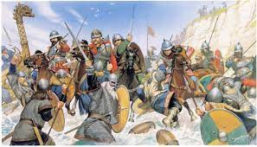
Key Content (New Learning)
Know that The Romans invaded three times and what happened as a result. |  | know about the battle of Hastings and William the Conqueror. | Know that Vikings and Anglo Saxons invaded England. | know the place of Anglo-Saxon kings and the uniting of England.
Unit Overview |  |  |  | Key Vocabulary
Lesson 1 Lesson 2 Lesson 3 Lesson 4 Lesson 5 End Point | Romans/ Vikings- Fact finding. Roman/Viking’s life - What did the Romans/Vikings do for us? To know about the battle of Hastings. Identify what the Vikings and Anglo Saxon did to England. Vikings - End of Viking times in Britain Explanation text |  |  | Romans –A cultural group, variously referred to as an ethnicity or a nationality Vikings – Any of the Scandinavian seafaring pirates and traders who raided and settled in many parts of north-western Europe in the 8th–11th centuries. Agriculture – Practice of farming. Tapestry – a piece of thick textile fabric with pictures or designs. Conqueror – a person who conquers a place or people; a vanquisher.
History Knowledge Organiser
Unit 1 – Invaders

