Slide 1
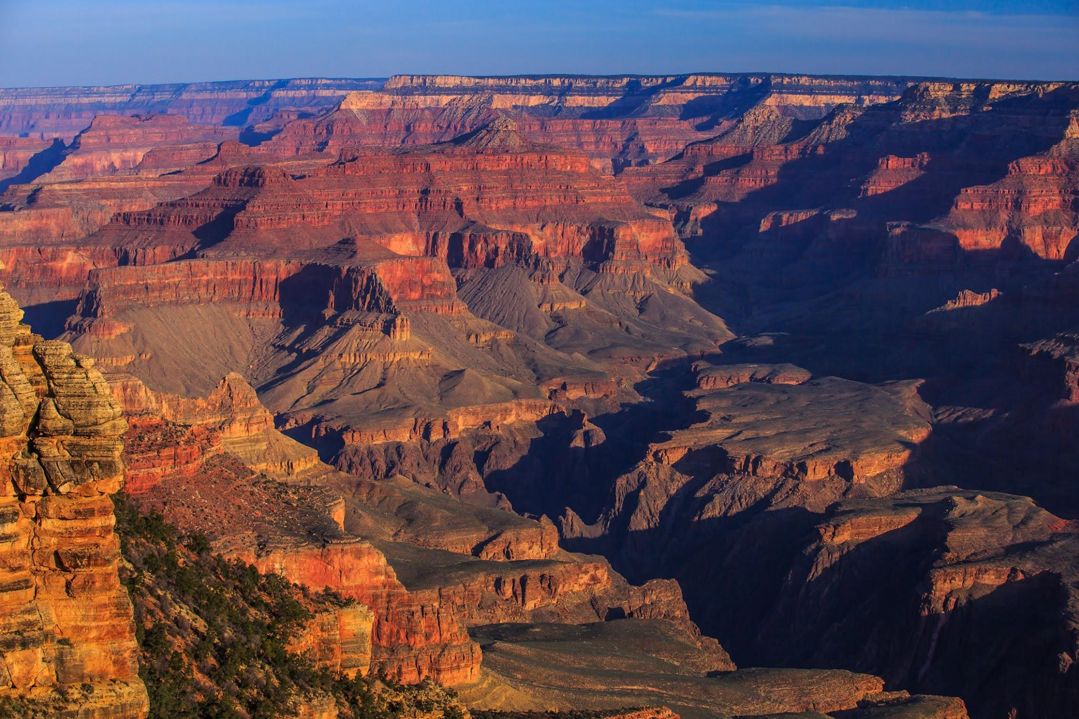
Key Content (New Learning)
To know about the different environments and biomes in the Grand Canyon |  | To understand how the Grand Canyon was formed
Unit Overview |  |  |  | Key Vocabulary
Lesson 1 Lesson 2 Lesson 3 Lesson 4 Lesson 5 End Point | To locate the Grand Canyon and identify key features. To understand how the Grand Canyon was formed To learn about the environment at the bottom of the Grand Canyon. To know about the different environments and biomes in the Grand Canyon To consider the types of settlement and land use in and around the Grand Canyon and know how humans use the Canyon. A presentation from notes in your book about the Grand Canyon- a fact from each lesson. |  |  | Formation- the way in which a thing is formed. Features- a part or quality of something. Biomes- a major type of global region, such as forest, desert, or grassland, characterized by the community of plants and animals that have adapted to life under the particular soil and climatic conditions that a particular region presents. Environments- everything that surrounds a particular type of living thing and affects its growth and health. Settlements- a place where people have recently settled
Geography Unit Overview
Unit 2 - Canyons

