Slide 1
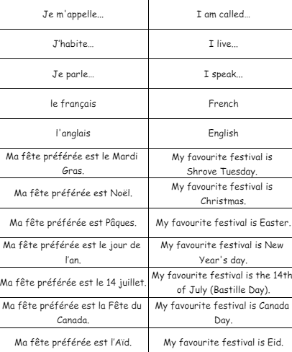
Key Content (New Learning)
Identify places on a map of the world and label in french |  | Explore different religions and their celebrations | Compare 2 of the locations in French
Lesson 1 Lesson 2 Lesson 3 Lesson 4 Lesson 5 End point | To be introduced to the 4 main characters and their locations To learn more about a key festival/celebration in the four countries To expand our knowledge on different religious celebrations To compare where two of our characters live To discuss how the characters are going to be global citizens End of unit assessments- speaking, listening, reading, and writing
French
Unit 6- me in the world (moi dans le monde)

