Slide 1
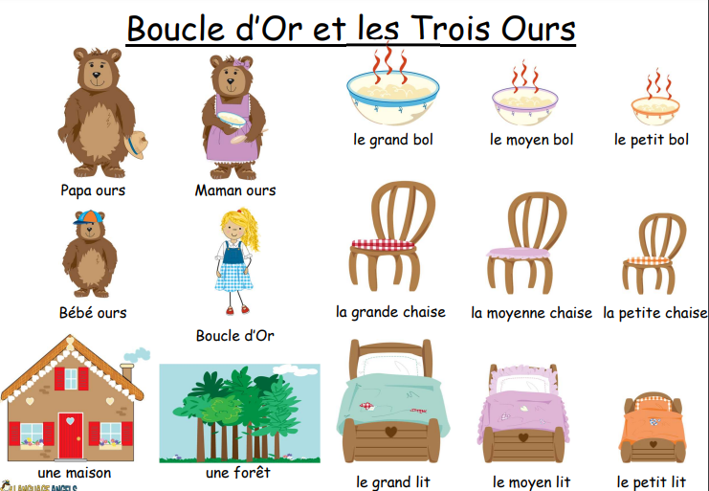
Key Content (New Learning)
Listen attentively to a whole familiar fairy tale in French. |  | Remembering new language using picture, word and phrases cards. |  | Attempt to retell a familiar fairy tale in French using a mini book for support.
Unit Overview
Lesson 1 Lesson 2 Lesson 3 Lesson 4 Lesson 5 End Point | To listen to the familiar fairy tale Goldilocks in French and understand the meaning using picture cards. To listen to the familiar fairy tale and retain more new vocabulary using word cards. To listen to the familiar fairy tale and consolidate my new knowledge with phrase cards. To use my new knowledge to rewrite the story of Goldilocks in French. To present my version of the story to the class. End of Unit Quiz |  |  | Key Vocabulary
Term 6 French Unit Overview
Goldilocks and the Three Bears
Improve gist reading and gist listening skills.

