Slide 1
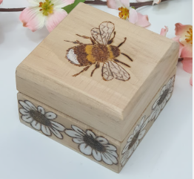
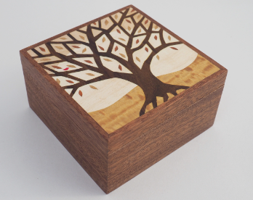
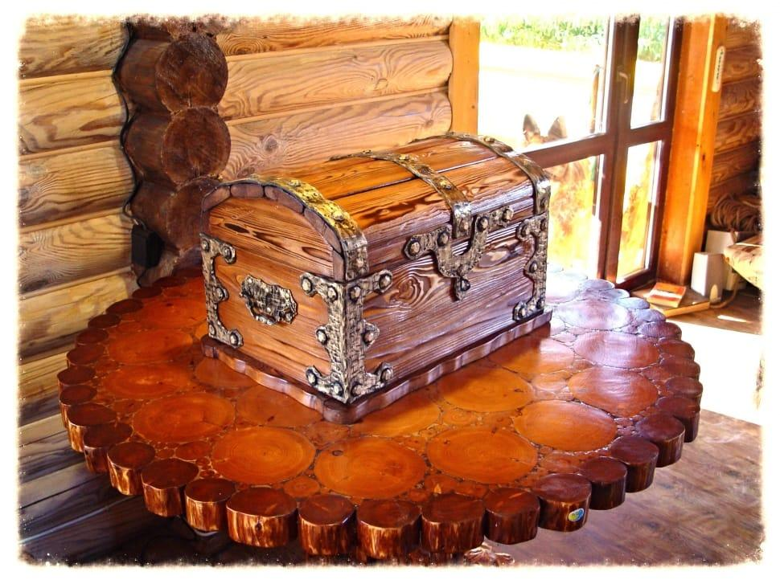
Key Content (New Learning)
Begin to use sheet materials and construction tools with appropriate supervision. |  | Develop and use knowledge of how to construct strong, stiff shell structures. | Develop and use knowledge of nets of cubes and cuboids and, where appropriate, more complex 3D shapes. | Know how to follow a basic method to make a structure independently to Construct a box.
Unit Overview
Lesson 1 Lesson 2 and 3. Lesson 4 Lesson 5 ( end point ) | Explore actual trinket boxes. Plan a trinket box (using a net of a cube). Mark out where to cut using measuring tape and pencil. Use a saw to cut the sheet material. Use sandpaper to smooth cut edges. Use a glue gun to attach pieces together. Attach the lid. Paint the pieces of your box. Evaluate your trinket box. |  |  | Sheet Material- Engineered wood boards that are made from recycled wood. Vice - specially designed to secure wood pieces without damaging the surface. Structure - A structure is something of many parts that is put together. Assemble - to bring together all the pieces. Sandpaper - Sandpaper is a special thick paper with a rough, abrasive surface that smooths wooden surfaces.
DT Unit Overview
Term 6 - Construction

