Slide 1
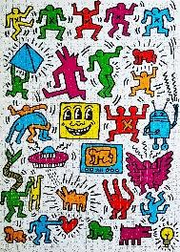
Key Content (New Learning)
Know who Keith Haring was and what type of art he produced |  | Design a print that you can produce | Experiment with different textures | Try new materials that will make your design abstract
Lesson 1 Lesson 2 Lesson 3 Lesson 4 Lesson 5 End point | To know the life and work of Keith Haring To design your print To make a collagraph Finish your collagraph and print Evaluate your final piece Final project- collagraph and printing |  |  | Printing- to make several "prints" of the same image, in order to create the image you desire Collagraph-a collage of materials of various textures glued on to a printing plate, often a thin wood or cardboard. Abstract- art that does not attempt to represent an accurate depiction of a visual reality but instead uses shapes and colours
Art
Unit 3- printing

