Slide 1
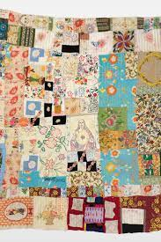
Art Knowledge Organiser
Unit 1 – Rosie Lee Thompson – Shopping bags.
Key Content (New Learning)
Research an artist. |  | Use different type of stitch work. | Design and create a shopping bag in the style of an artist. | Evaluate a shopping bag.
Unit Overview |  |  |  | Key Vocabulary
Lesson 1 Lesson 2 Lesson 3 Lesson 4 Lesson 5 End Point | To research the life and work of Rosie Lee Tompkins. Practise different stitches. (Running stitch, backstitch, satin stitch, fishbone etc). Design decoration of a shopping bag. Decorate a shopping bag (print / dye) Decorate a shopping bag (stitch / weave). Create and evaluate your bag. |  |  | sewing – . Sewing is the activity of making or mending clothes or other things using a needle and thread. Threading – To move through a place by carefully going around things that are blocking your way Backstitch – a stitch sewn one stitch length backward on the front side and two stitch lengths forward on the reverse side to form a solid line of stitching on both sides. Weaving – the textile art in which two distinct sets of yarns or threads Printing - An artistic process based on the principle of transferring images from a matrix onto another surface, most often paper or fabric.

