Slide 1
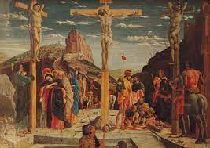
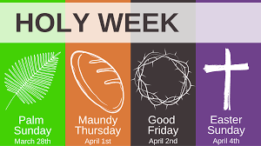
Key Content (New Learning)
To know that people have control over some events in their lives. |  | Know whether God intended Jesus to be crucified or whether jesus’ crucifixion was the consequence of events during holy week. | Know and express my opinion about jesus’ crucifixion being his destiny/purpose.
Unit Overview |  |  |  | Key Vocabulary
Lesson 1 Lesson 2 Lesson 3 Lesson 4 Lesson 5 Lesson 6 End Point | To know what you have the most control over in life. To know what God’s plan was for Jesus. To understand the events of Holy Week (Palm Sunday - Last supper) To understand the events of Holy Week (Mount of Olives - Burial) To understand if Jesus was aware of God’s plan/His purpose? To understand my own dream/ambition/purpose. Complete a Holy Week display. |  |  | Holy Week: – a special week during which they can reflect on Lent and their faith before celebrating Easter. Incarnation: – literally means 'to take on flesh'. It shows that Jesus was fully God and fully human. Crucifixion: – Roman method of execution by nailing someone to a cross, often until they die of asphyxiation Sacrifice: – a loss or something you give up, usually for the sake of a better cause. Destiny: – a future that someone or something will have.
RE Knowledge Organiser
Term 4 – Christianity

