Slide 1
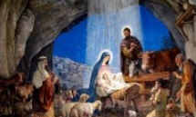
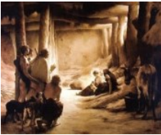
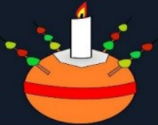
Key Content (New Learning)
know how ‘true’ could mean different things to different people, and how stories can be ‘true’ in different ways. |  | know that the Christian belief that Jesus was the Incarnation of God. | know whether the Christmas story is true and what this might mean to Christians.
Unit Overview |  |  |  | Key Vocabulary
Lesson 1 Lesson 2 Lesson 3 Lesson 4 Lesson 5 End Point | explore the different types of truth. explore the Christmas story in the bible. investigate different accounts of the Christmas story. understand that Christians believe that Jesus was the incarnation of God. explore whether the Christmas story is true. Complete a table using all learning to decide whether the Christmas story is true. |  |  | Objective – not influenced by personal feelings or opinions in considering and representing facts. Incarnation – The Christian belief that Jesus is God in a human body. The word ‘incarnate’ is Latin for “in the flesh.” Christingle – A symbolic object that means 'Christ's light'. Symbol – A sign, shape or object with a special meaning that is used to represent something else. Jesus – Christians believe Jesus is the Son of God. Advent - The first season of the Church year, leading up to Christmas and including the four preceding Sundays.
RE Knowledge Organiser
Term 2 – Christianity

