Slide 1
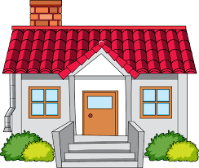
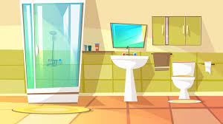
Key Content (New Learning)
Say and write in French whether we live in a house or an apartment |  | Say what room we have and do not have at home using the key structure chez moi il y a… and chez moi in n’y a pas de/d’… | Use the connective/conjunction et to link two sentences together
Unit Overview |  |  |  | Key Vocabulary
Lesson 1 Lesson 2 Lesson 3 Lesson 4 Lesson 5 End Point | Learn how to say where I live using j’habite Learn 10 nouns and determiners for rooms of the house Learn how to say I do not have… a certain room in the home use my knowledge to describe where i live End of unit assessment and consolidation End of unit assessment |  |  | Où habites-tu ?– Where do you live? J’habite dans… – I live in… une maison– a house en ville– in town une cuisine– a kitchen une chambre- a bedroom un jardin - a garden un sous-sol - a basement
French Knowledge Organiser
Term 2 – My home

