Slide 1
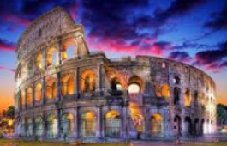
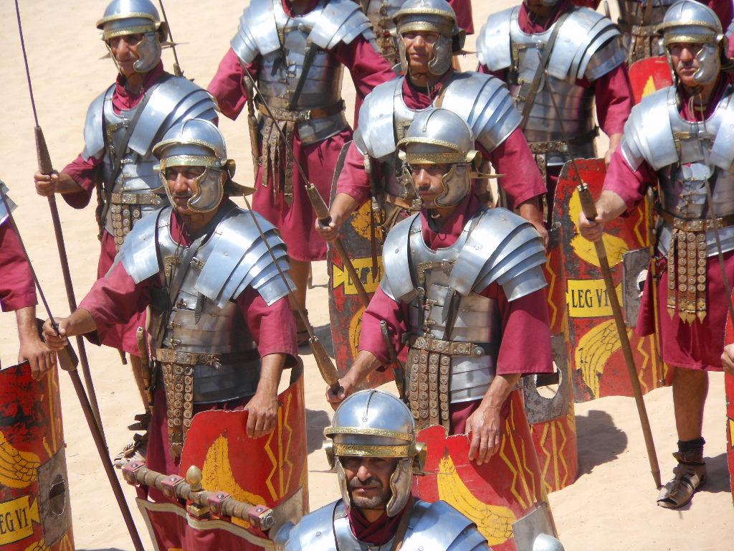
Key Content (New Learning)
To know why and when the Romans invaded and settled in Britain |  | To know about the Roman army both the Legions and Auxiliary | To know that the people already here were called Celts and they revolted (Boudicca) | To know what the Romans left behind in Britain - Houses, roads etc.
Unit Overview
Lesson 1 Lesson 2 Lesson 3 Lesson 4 Lesson 5 End Point | Write a newspaper report recounting some of the details of the invasion. When was Britain successfully invaded and by whom? Create a poster showing the differences between Legions and Auxiliaries. Why was the army so successful? To retell the story of Boudica’s revolt. Why did they revolt against the Romans? How did she died? To match Roman buildings up with their purpose. What did the Romans leave behind that we still use today? Write a letter applying to be a gladiator. What Did the Romans do for entertainment? What was life like as a gladiator? End of Unit test |  |  | Key Vocabulary- Invaded - to enter a place in large numbers, usually when unwanted and in order to take possession or do damage Legions- a legion is a large unit of men in the army. Made up of around 6000 soldiers. Auxiliary - men drawn into the army from across the Roman empire, sometimes voluntarily, sometimes by force. Celts - People living in Britain tribes. Rebellion- a revolt by people who want to challenge what they believe is unfair treatment by the ruler.
History Unit Overview
Term 5 - The Romans

