Slide 1
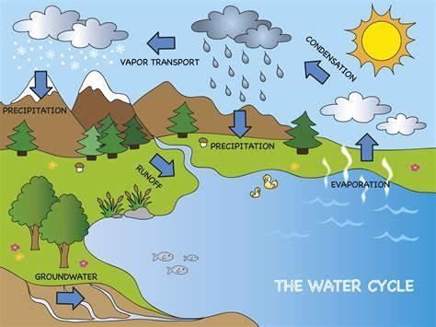
Key Content (New Learning)
Identify different types of water bodies (lakes, rivers, oceans, seas, reservoirs, bays, gulfs, straits, glaciers, and fjords) |  | Identify parts of the water cycle (also known as the hydrological cycle) and explain how it is important | Explore using data to answer questions about water usage | Explore the water treatment process and why it is needed.
Lesson 1 Lesson 2 Lesson 3 Lesson 4 Lesson 5 End point | To explore water on our planet To understand and explain the water cycle To explore why we need water and how we use it. To compare the difference in water availability and usage in the UK and Kenya. To explore how water can be used for power to contribute to a sustainable future Present learning from the term in small groups |  |  | Precipitation- small water droplets form in clouds they then fall to the ground Evaporation- liquid is heated and turns into gas and rises into the air as water vapour Infiltration- water soaks into the ground through soil Transpiration- water in leaves gets warm and evaporates Condensation- water vapour cools down and is liquid Transportation- water in clouds moves across the ocean and back to land
Geography
Unit 4- blue planet

