Slide 1
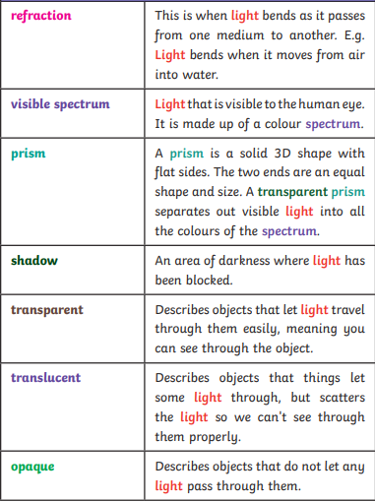
Key Content (New Learning)
We need light to be able to see things. Light waves travel out from sources of light in straight lines |  | A shadow is always the same shape as the object that casts it. | Shadows can also be elongated or shortened depending on the angle of the light source.
Lesson 1 Lesson 2 Lesson 3 Lesson 4 End point | To know how we see light and how it travels Know how shadows are formed Plan my investigation Carry out and evaluate my investigation End of unit assessment
Science
Unit 3- light

