Slide 1
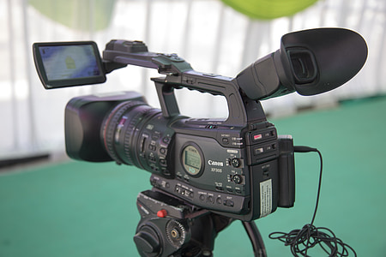
Key Content (New Learning)
know the features of an effective video |  | know which devices to use to capture video | Know that video is moving pictures that may incorporate audio
Unit Overview |  |  |  | Key Vocabulary
Lesson 1 Lesson 2 Lesson 3 Lesson 4 Lesson 5 End Point | To know what makes a video effective and know which devices can record video To capture video using a range of techniques. To create a storyboard. To identify that video can be improved through reshooting and editing To evaluate the choices made when making and sharing a video You will have made a video of your own. |  |  | Video- the picture part of television. Record- copy by use of a mechanical or electronic device for later hearing or viewing. Techniques- the particular method or way of doing or performing something. Reshooting- to redo a part in order to improve.
Computing Unit Overview
Unit 2 - Video production

